Slide 1



Faculty Senate
April 16, 2026

Slide 2
Meeting Guidelines
Attendance
Virtual attendance will be captured through Zoom (no sign-in required)
Proxies
Proxies who have NOT notified the office prior to the meeting should notify faculty.senate@oregonstate.edu NOW so that they can be added to Canvas before any motions are opened.
In-person attendees should sign in on the paper sheets at the back of the room.
Online Participation
Senators and guests online may submit their questions either through the Q&A feature or, if they wish to speak, through raising their hand to be unmuted. Please do NOT use the chat to submit your question.
Voting
Motions from the Floor
Please make sure your Canvas is open throughout the meeting.
When a vote has been announced, refresh the page to see the open motion.
If you plan to make a motion from the floor at today's meeting, please send the language of your proposed amendment to faculty.senate@oregonstate.edu.
Voting will be open in Canvas for ~1 minute per motion.
Please note that questions and comments from senators will be prioritized. Guest questions will be addressed if there is additional time.

Slide 3
Faculty Senate Meeting Agenda – April 16, 2026
Topic | Presenter(s)
Comments & Updates from the Faculty Senate President | Jacob Hamblin
Writing Intensive Curriculum (WIC) Learning Outcome, Criteria, and Rational (LOCR) | Kendon Kurzer, Kelsey Emard
Administrative Modernization Project (AMP) Update | Heather Riney, Tim Carroll, Bob Mason
Accreditation Site Visit Re-Cap | Rebecca Mathern
Action Item: Curricular Proposals | Kaplan Yalcin
Strategic Resource Renewal (SRR) Update | Jacob Hamblin
New Business | Jacob Hamblin

Slide 4
Updates from the Faculty Senate President
Jacob Hamblin, Faculty Senate President

Slide 5
Reminder: Committee Interest Form
The Committee Interest Form is open to all faculty interested in serving on Faculty Senate or University committees and councils. The form closes at 5:00 PM on April 20.
Please visit the Faculty Senate website to learn more about the committees and access the form.

Slide 6
Institutional Policy and Procedures for Program Reorganization or Elimination Review Subcommittee
Subcommittee Members:
Jacob Hamblin
Bruce Dugger
Eric Hansen
Kim Halsey
Jim Coakley
Susan Bernardin
Katheryn Yetter

Slide 7

OSU Faculty Senate
April 16, 2026

Slide 8


Proposed WIC Learning Outcomes, Criteria, & Rationale
Kendon Kurzer, WIC Director
WIC LOCR Recommendations Document: https://beav.es/WICLOCR
Slide deck: https://beav.es/WICLOCR2

Slide 9
Contents
Framing
Current/Proposed Criteria
WIC LOCR Committee
Current/Proposed Rationale
Current/Proposed Learning Outcomes
Questions/Concerns
01
04
02
05
03
06

Slide 10
Framing: Why WIC?
Writing/Communication is valued among employers
National Association of Colleges and Employers (2025): written communication skills = third highest sought after resume attribute
Top career readiness competency is communication; drops to 5th in recent grad ratings
Oregon 2024 Talent Assessment: 175k jobs
Identified key skills: technical , employability (leadership and communication), business (budgeting, scheduling)
OSU Alumni & Employer Survey Results
Education (2022): value professional learning and communication skills
Across fields
Health care, finance, journalism, manufacturing, engineering, agriculture, retail (2020): value documentation and audience awareness/adaptation
STEM (2016; 2019): written communication skills > oral communication or numeracy
Business (2022; 2024): communication is top for both students and employers; recent grads score their own abilities more highly than employers do

Slide 11

Framing: Why LOCR WIC?
With new Core Ed successfully launched, WIC needed updates to fit that framework and emphasize modern disciplinary writing norms.
WIC LOCR Committee formed end of Fall, 2025, with representatives from all undergraduate-serving colleges, Cascades, and Assessment.
Committee met January and early February.
Meetings with colleges (COE, CAS, CEOAS, COS), college designees, and Faculty Feedback Forums (February and March).
Revised version approved by LOCR Committee end of W26

Slide 12



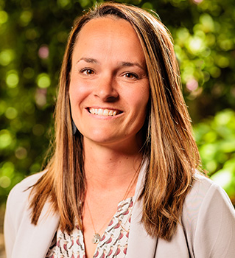




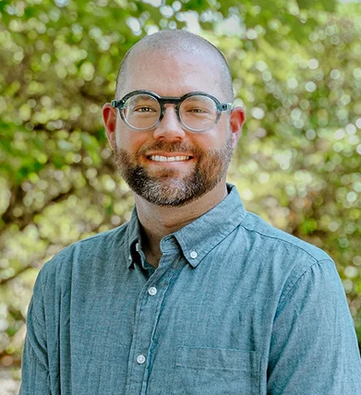

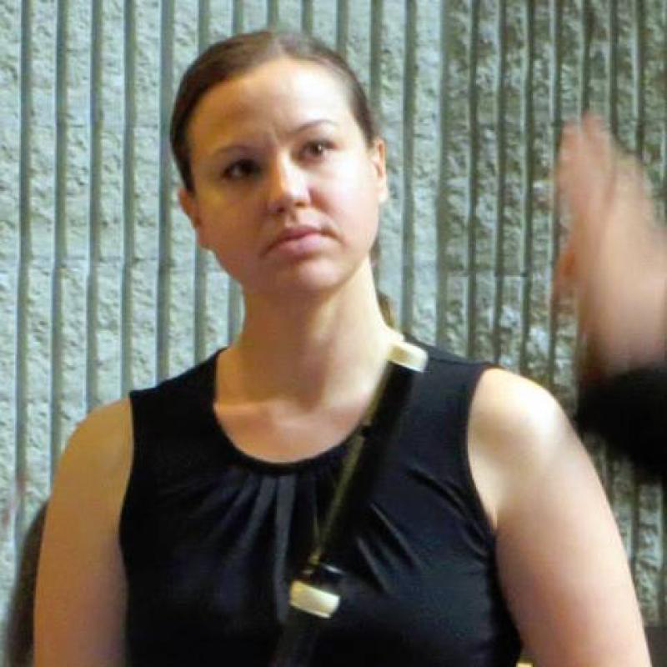

Meet the WIC LOCR Committee
Patrick Ball
Penny Diebel
Sara Wright
Andrea Allan
Cascades
Agricultural Sciences
Education
Earth, Ocean, Atmospheric Sciences
John Morris
Judy Liu
Kirsten Winters
Stacy Rosenberg
Business
Engineering
Engineering
Forestry
Sam Logan
Kristy Kelly
Kimary Fick
Lauren Dalton
Health
Liberal Arts
Liberal Arts
Science
Kristin Nagy Catz
Director of Assessment

Slide 13

Learning Outcomes: Students in WIC will….
Current WIC
Develop content knowledge and critical thinking in the discipline through frequent practice of informal and formal writing.
Determine and utilize audience expectations, genres, and conventions appropriate to communicating in the discipline.
Compose a document of at least 2000 words through multiple aspects of writing, including brainstorming, drafting, using sources appropriately, and revising comprehensively after receiving feedback on a draft.
Proposed WIC
Analyze disciplinary concepts through writing.
Create at least one original, extensive, and meaningful written work that adheres to disciplinary norms including specified audience, purpose, and genre.
Integrate feedback after critical evaluation during the revision process of written work.
WIC LOCR Recommendations Document: https://beav.es/WICLOCR

Slide 14

Criteria: WIC courses will….
Current WIC
Use student writing as a significant approach to learning
Regular/frequent opportunities to write (both graded and ungraded)
One paper on controversial question and integration of 1+ source
5000+ words (2000 should be in polished papers after receiving feedback and criticism)
Restrict enrollments to manageable size (ideally no more than 20 students)
Proposed WIC
4. Require students to produce original
written work, totaling at least 4000
words.
WIC courses must include at least 1500 words of write-to-learn/low stakes assignments.
WIC courses must include at least one 1500 (or more) word extensive formal writing assignment on a relevant and substantive topic using sources in discipline-appropriate manners.
The remaining 1000 required words are left to the instructor’s discretion.

Slide 15
Criteria: WIC courses will….
Current WIC
Use student writing as a significant approach to learning
Regular/frequent opportunities to write (both graded and ungraded)
One paper on controversial question and integration of 1+ source
5000+ words (2000 should be in polished papers after receiving feedback and criticism)
Restrict enrollments to manageable size (ideally no more than 20 students)
Proposed WIC
5. Feature feedback provided by the
instructor of record at least one week
prior to the assignment’s final due date on at least one writing assignment.
10. Give students practice evaluating and
integrating multiple relevant (primary
and/or secondary) sources with appropriate citations.
WIC LOCR Recommendations Document: https://beav.es/WICLOCR

Slide 16
Criteria: WIC courses will….
Current WIC
Use student writing as a significant approach to learning
Regular/frequent opportunities to write (both graded and ungraded)
One paper on controversial question and integration of 1+ source
5000+ words (2000 should be in polished papers after receiving feedback and criticism)
Restrict enrollments to manageable size (ideally no more than 20 students)
Proposed WIC
7. Require student-to-instructor ratios of no more than 25-to-one.
8. Graduate students may not be assigned as
instructors-of-record for WIC courses.
9. Require new-to-WIC faculty to participate in
university-approved WIC training (or its equivalent).
Instructors must have ongoing university-approved training and continuing education to remain certified in WIC at least once every three years.
GTAs who are providing feedback on student writing must also go through university-approved training.
Notes:
We include a clause that GTA training must be regularly offered.

Slide 17
Criteria: WIC courses will….
Current WIC
2. base a significant part of the grade on evaluation of writing.
Papers at least 30% of the overall grade; 25% based on individually written papers.
Collaborative projects are “appropriate” but individual papers must be a significant portion of the grade.
Proposed WIC
4. Require students to produce original
written work, totaling at least 4000
words.
c. At least 35% of students’ grades in WIC courses should come from writing assignments (both low stakes and formal).
6. Include assessment of individually written
work which has been revised after
feedback. Collaborative projects written by student teams may be used to partially meet WIC requirements but may not comprise the entirety of assessment.

Slide 18

Other Proposed Criteria: WIC courses will….
10. Include assignments and/or discussion that address at least two distinct audiences using at least two types of writing (only one of which must be a formal assignment).
Classroom discussion and/or assignments will include review of what writing looks like in the discipline, with provided examples.
12. Include discussion and consideration of AI assistive tools and use norms (or absence) within the
discipline, although instructors are not required to either adopt or refuse student use of generative AI within WIC courses.
13. Require Writing Elevation as a prerequisite.
WIC LOCR Recommendations Document: https://beav.es/WICLOCR

Slide 19
Logistics Criteria: WIC courses will….
Be worth a minimum of 3 credits, although, when possible, WIC courses should be at least 4 credits to reflect the time-intensive nature of these courses for instructors and students.
WIC Learning Outcomes and Criteria can be achieved by combining multiple courses in a series required for the major. When this is the case, any change to any of the involved courses prompts a review of all involved courses together.
The WIC requirement will not be completed until all involved courses have been successfully passed by the student.
WIC course credits do not count towards Core Ed credit requirements but do contribute to major credit requirements.
Be offered at the 300-400 level and restricted to students with junior or senior status.
Be regularly numbered departmental offerings rather than x99 or blanket number courses.

Slide 20
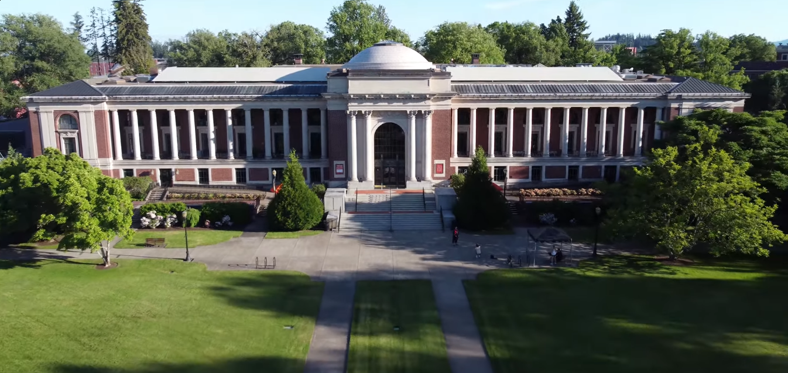
Rationale:
Current WIC
Beyond the writing skills and practice gained in WR I and WR II courses, students need to learn to write as members of the discipline or disciplines in which they have chosen to major. Writing Intensive courses, which are taken in the major, typically in the junior or senior year, introduce students to the genres, purposes, audiences, content, and conventions of writing in the major. Student writers gain experience with the resources used in their field and the formats and documentation style used to communicate knowledge. Through inquiry-based writing in the discipline, students gain understanding and knowledge of disciplinary goals and concepts. Students are encouraged to complete Writing I and Writing II requirements before enrolling in their WIC course.
Proposed WIC
Beyond the writing skills and practice gained in Writing Foundations and Elevation courses, students need to learn to write as members of the discipline. Writing Intensive Curriculum courses, which are taken in the major in the junior or senior year, introduce students to the genres, purposes, audiences, content, and conventions of writing in the discipline. Student writers gain experience with the resources used in their discipline and the formats and documentation style used to communicate knowledge. Through inquiry-based writing in the discipline, students gain understanding and knowledge of disciplinary goals and concepts. Students are required to complete Writing Foundations and Elevation requirements before enrolling in their WIC course to leverage the vertical alignment of skills learned in these courses.

Slide 21
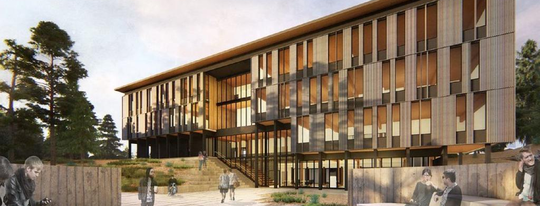
Some Common Reactions/Concerns
Authentic attention to disciplinary norms
Increased flexibility (re: word counts)
Validation of current creative approaches (re: collaborative projects)
Attention to workplace genres/genAI tools
Workload for WIC instructors
Training requirements (instructor/TA)
CIM updates
Workload creep (teaching multiple sections)
Costs
Training (instructor/TA)
Continued low course caps
Logistics
WE as prerequisite
Tracking training

Slide 22
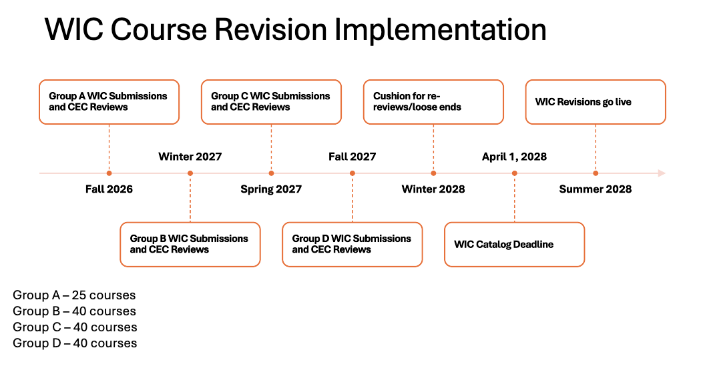

Slide 23


Questions? Comments?
Feedback survey: https://beav.es/WICLOCR3
Direct email: kendon.kurzer@oregonstate.edu

Slide 24
OSU Faculty Senate
April 16, 2026

Slide 25

Administrative Modernization Program Update
Faculty Senate Meeting // April 16, 2026

Slide 26

AMP: A Strategic Imperative for OSU’s Future
What is the AMP?
AMP is a three-year, $81.3M program to modernize administrative processes and replace the university’s core information technology systems supporting administrative work
What is AMP’s impact
Frees up time and resources
Improves daily experience
Strengthens community impact

Slide 27
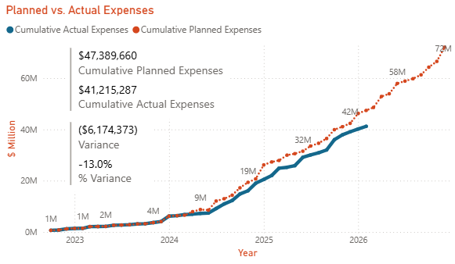
AMP Remains On Schedule, On Budget
The program is projected to generate $10.8M in annual savings by FY2028
Cleaner data, better systems, and a more agile way of working will enable our other critical initiatives

Slide 28
Recap of User Experience Review (UER)
User Experience Review (UER) Recap
405
38
Total Registered Participants
Communities Represented
53
525
Total Sessions
Total Feedback Submissions

Slide 29
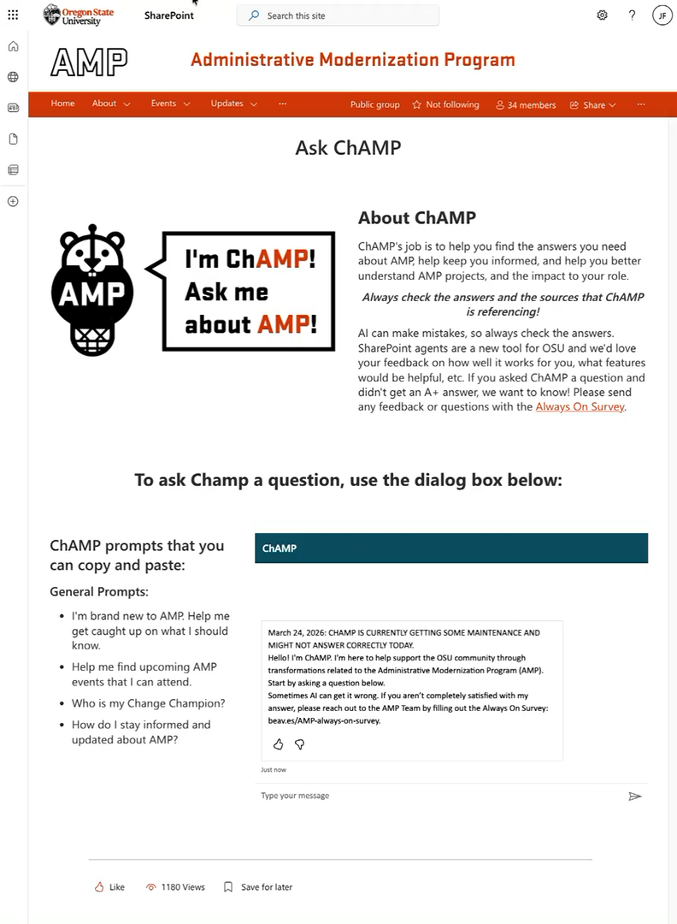
Cutover: What to Expect
Primary impact expected June 2026: Most system outages are expected in June 2026. Limited outages may continue into July 2026. Some administrative activities required earlier planning and completion starting in March 2026.
Note:
Academic processes will not be pausing in June, including summer hiring for Academic and Graduate Assistants

Slide 30
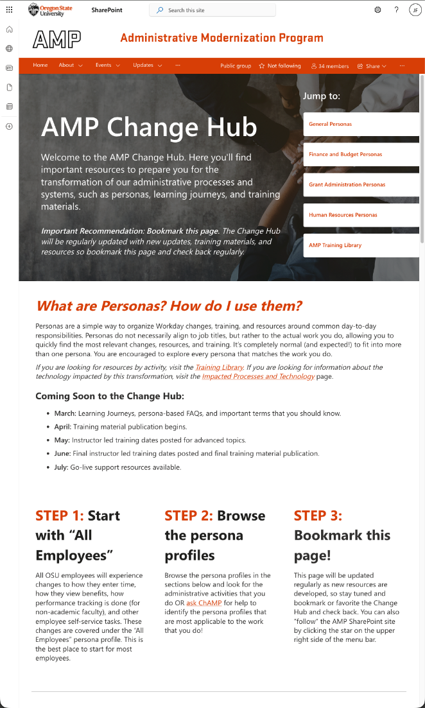
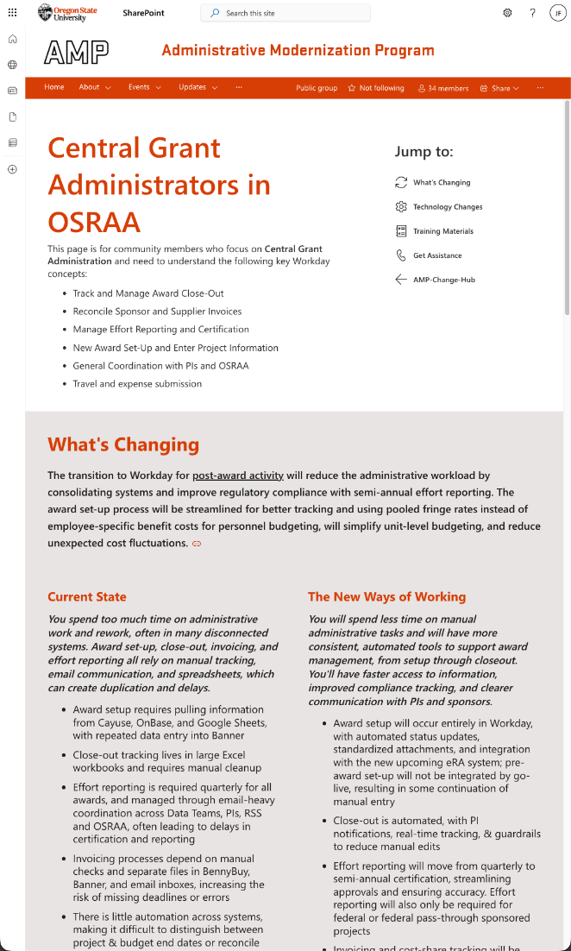
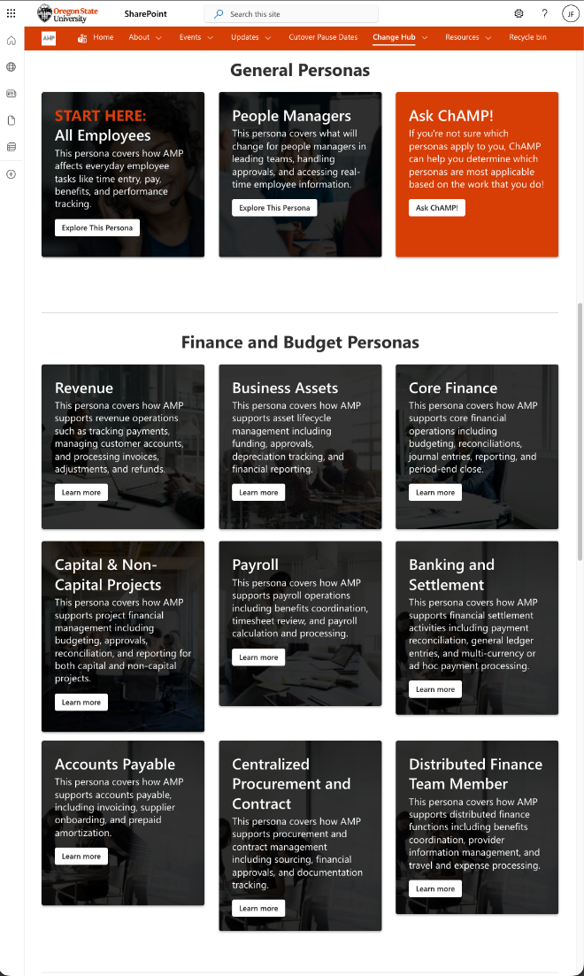
Training
Train-the-trainer sessions have started, and go-live training will be delivered for impacted employees before July
For academic faculty and 9- and 10-month employees (Aug – Sep) their AMP learning journeys will begin after summer break
Change Readiness Assessment #5
The fifth CRA launches April 27 and closes May 9
Faculty will be invited to participate for the first time

Slide 31
Upcoming Events
AMP Readiness Series: Academic Faculty – April 28
Clear, high-level introduction to how AMP and Workday will affect academic faculty
AMP Get Ready for Go-Live Fair – May 1
Will feature key demos, Q&As, and July go-live expectations to help prepare for the transition
AMP Leadership Update: Get Ready for Go-Live – May 1
Panel discussion on what to expect and how to prepare for go-live, support and resources available and recent community feedback
AMP Readiness Series: 9 and 10 Month Employees – May 12
User Experience Review
Training
Go-Live!
Post Go-Live Support and Continuous Improvement
Primary Faculty Training
Feb
Mar
Apr
May
Jun
Jul
Aug
Sep

Slide 32
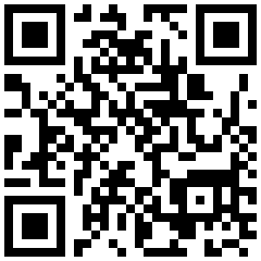
AMP Quick Links
AMP SharePoint: beav.es/AMP-sharepoint
Ask ChAMP your AMP questions: beav.es/about-ChAMP
Check out the AMP Change Hub
Find your Change Champion: beav.es/AMP-change-champions
Ask questions and submit feedback via the Always On Survey: beav.es/AMP-always-on-survey
AMP Video Library: beav.es/AMP-video-library
AMPlifier (AMP’s Newsletter): beav.es/AMPlifier
Questions?
AMP.OREGONSTATE.EDU

Slide 33






HOW AMP MAY IMPACT PRINCIPAL INVESTIGATORS
I am Mark, a Research Faculty Member
Currently:
I spend too much time coordinating awards, closeouts, and certifications across systems, relying on manual emails and Excel tracking.
Notifications and invoicing are handled manually, requiring coordination across teams and tools
Effort reporting is time-consuming and delayed due to payroll lockouts
Award and budget visibility is fragmented, needing multiple systems to verify charges
In the future:
With Workday, I’ll spend less time on manual tracking, have real-time fiscal info, and benefit from automation that streamlines certification, closeouts, and invoicing:
Automated notifications for closeouts and amendments
Effort certification only twice a year, tracked in real-time
Instant payroll and budget updates for better transparency
Subaward and supplier invoice approvals handled directly in Workday
Frequent Activities I Perform | The System Where I Currently Complete This Task | Where I will Complete This Task in the Future
Track Award Activity and Close-Out Verify Award, Budget, and Charges Manage Effort Reporting and Certification | ALSO KNOWN AS BANNER EXCEL
Notification for Close-out Adjustments | OUTLOOK
Approve Subaward and Supplier Invoices | ALSO KNOWN AS BENNYBUY

Slide 34



HOW AMP MAY IMPACT MANAGERS
I am Michelle, a Manager at OSU
As a manager, I’ll gain access to more efficient tools and real-time data to support my team, making administrative tasks easier to manage. AMP introduces clearer guidance around standard delegation of administrative tasks.
Currently:
I am spending too much time on administrative work and rework, often in multiple disconnected systems.
Spends significant time on manual administrative work across multiple systems (e.g., BennyBuy, Banner, PeopleAdmin)
Must manage benefits, payroll, time-off approvals, and evaluations via separate tools
Relies on emails and spreadsheets for leave balances and performance tracking
Faces delays and confusion in payroll processing, pay stub interpretation, and leave reporting
Has limited visibility into employee schedules, disciplinary history, and overall team data
In the future:
I will spend less time on administrative tasks, most of which will move to Workday. I will have an easier and faster time hiring new employees.
Majority of administrative tasks move into Workday, reducing manual re-entry in disparate systems and supporting faster hiring and approvals
Gains centralized visibility into payroll, time-off, benefits, and performance
Automated notifications for evaluations, LOA requests, and timesheet approvals streamline workflows and ensure key dates and actions aren’t missed
Pay stubs and leave balances become clear and accessible in real-time
Employees manage their own updates (address, benefits, etc.) through self-service tools, freeing manager time
Frequent Activities I Perform | The System Where I Currently Complete This Task | Where I will Complete This Task in the Future
Time-Off Management
Payroll Benefits Leave Reporting Employee and Team Visibility | ALSO KNOWN AS BANNER
Hiring and Approvals

Slide 35

PERSONA BASED LEARNING
Each role at OSU will have a unique learning journey aiming to support your new ways of working with Workday. Learning Journeys will be available on the AMP Change Hub beginning in March 2026.
Sample Learning Journey
I am Marcy, an OSU Employee
1
2
ONGOING OPPORTUNITIES
Attend AMP Demo Days and Community Check-ins
FEBRUARY/MARCH
Participate in User Experience Review (preview of new system)
Tech-Enhanced Learning Resources
Navigator tours: Step-by-step, in-app guidance for high-traffic tasks
Workday help text: Immediate, OSU-specific instructions within Workday
Demos: Scenarios recorded/previews on topics employees care about most
4
3
JULY (GO-LIVE!)
Log into Workday, complete day-one checklist, and access on-demand resources and support
MAY – JUNE
Complete Learning Journey to prepare for Workday
APRIL
Review my detailed AMP Learning Journey (sent via email to all employees)
Additional Learning Resources
5
6
On-demand job aids (PDFs)
On-demand quick reference (PDFs)
Instructor-led training
AUGUST
Access on-demand resources and trainings, attend office hours, and submit service desk tickets as needed
ONGOING SUPPORT
Access on-demand resources and trainings available in Workday Learning

Slide 36
Administrative Modernization Program Update
Faculty Senate Meeting // April 16, 2026

Slide 37
OSU Faculty Senate
April 16, 2026

Slide 38
Accreditation Site Visit Re-Cap
Rebecca Mathern, Associate Vice Provost for Academic Affairs, University Registrar

Slide 39




Slide 40
Site Visit Complete!
OSU-Cascades: Amazing show and commitment
Corvallis: Excellent participation
Exit Meeting: Real time and live stream
Friday afternoon: RECOVERY

Slide 41
Engagement Numbers
Highlights:
Over 235 staff during the classified/professional faculty forum
99.5% attendance rate for meetings
Cascades exceeded all expectations: 125 participants!
Over 600 participants total

Slide 42
Commendations (Exit Meeting)
The development and widespread adoption of the PWS strategic plan.
The embodiment of ESG through the thoughtful design of support services for all students including Ecampus and transfer students.
The culture of collaboration across the university community and with external partners.
Fostering and promoting a universitywide culture of learning assessment among its academic and professional faculty.
Faculty members' intentional redesign of Core Education and the development of an assessment plan that provides the opportunity to collect meaningful data for continuous improvement.
The institution's master's and doctoral programs, offered across all campuses and modalities, with institutionally meaningful learning outcomes, assessment processes, and comprehensive support services.

Slide 43
Recommendations(Exit Meeting)
The institution systematically assess its Core Education category-specific learning outcomes and use the findings to continuously improve student learning. (1.C.6, 1.C.7)
The institution establish and publish on its website a student achievement indicator for post-graduation success. (1.D.2, 1.D.3)

Slide 44
Next Steps
Peer Evaluation Team's report
Report is received this week and reviewed for correction of facts. The report is then sent to the commission.
NOTE: The initial commendations and recommendations could change. The Commission is the final determinant.
Commission meets July 7-10, 2026
Final letter with official commendations and recommendations will be received within 30 days.

Slide 45

Thank you!
To all who engaged in this reaccreditation process, and
to everyone for their daily commitment to continuous improvement and dedication
to their work at OSU.

Slide 46
OSU Faculty Senate
April 16, 2026

Slide 47

Program proposalS FOR APPROVAL BY Faculty senate
Kaplan Yalcin, Curriculum Council Co-Chair

Slide 48
College Student Services Administration Graduate Major (EdM, MS))
CIM Key 161
Reviewed and approved by the following Faculty Senate Groups:
Budgets & Fiscal Planning Committee: Feb 23, 2026
Graduate Council: Mar 10, 2026
Curriculum Council: Mar 17, 2026
Executive Committee: Apr 3, 2026
(Reorg) College Student Services Administration (CSSA) program will be transferred from College of Liberal Arts to the College of Education

Slide 49
College Student Services Administration Graduate Certificate
CIM Key 669
Reviewed and approved by the following Faculty Senate Groups:
Budgets & Fiscal Planning Committee: Feb 23, 2026
Graduate Council: Mar 10, 2026
Curriculum Council: Mar 17, 2026
Executive Committee: Apr 10, 2026
(Reorg) College Student Services Administration (CSSA) program will be transferred from College of Liberal Arts to the College of Education

Slide 50
Ocean Technology Certificate (undergraduate)
CIM Key 948
College of Earth, Ocean, & Atmospheric Sciences
Reviewed and approved by the following Faculty Senate Groups:
Budgets & Fiscal Planning Committee: Feb 23, 2026
Curriculum Council: Mar 3, 2026
Executive Committee: Mar 20, 2026
(New) Integrates oceanography, engineering, and geospatial science into a practical, career-oriented curriculum

Slide 51
Early Childhood Leadership, Policy, and Practice Undergraduate Major (BA, HBA, BS, HBS)
CIM Key 951
College of Health
Reviewed and approved by the following Faculty Senate Groups:
Budgets & Fiscal Planning Committee: Feb 23, 2026
Curriculum Council: Mar 3, 2026
Executive Committee: Mar 20, 2026
(New) Interdisciplinary, combining coursework in Human Development and Family Sciences and Early Childhood with those that build skills in leadership, policy, and communications from a variety of disciplines

Slide 52
Request Faculty Senate Approval
Transferring College Student Services Administration (CSSA) programs from College of Liberal Arts to the College of Education
College Student Services Administration Graduate Major (EdM, MS)
College Student Services Administration Graduate Certificate
Ocean Technology Certificate (undergraduate)
Early Childhood Leadership, Policy, and Practice Undergraduate Major (BA, HBA, BS, HBS)

Slide 53
OSU Faculty Senate
April 16, 2026

Slide 54
Oregon State University: Strategic Resource Renewal
Update to Faculty Senate

Slide 55
OSU’s Strategic Resource Renewal follows a three-phase process
LATEST AS OF APRIL 13, 2026
Phase I: Diagnostic and Benchmarking
Phase II: Solution Design and Implementation
Phase III: Implementation and Ongoing Consultation
February-March 2026
April-July 2026
Fall 2026 and beyond
A comprehensive, university-wide assessment to understand OSU's current state, identify opportunities, and develop a fact-based menu of potential Projects
Co-developing detailed plans for a prioritized set of opportunities selected by university leadership, including clear owners, timelines, and expected impact
Supporting OSU leaders and teams as selected Projects move into execution and building the capabilities needed to sustain impact overtime

Slide 56
Phase I: Stakeholder Engagement
LATEST AS OF APRIL 13, 2026
Phase I: Focus Areas explored
Enrollment, Marketing and Financial Aid – On campus
Enrollment, Marketing and Financial Aid – Ecampus
Student Retention and Completion
Program Growth
Research and Innovation
Auxiliaries (e.g., Housing, Dining, Parking)
Cascades
Instructional Capacity
Administrative Optimization
External Spend
Capital Excellence
70+
30+
11
10+
interviews conducted
subject matter experts engaged
colleges engaged
administrative units engaged
25+
60+
5
500+
in-depth working sessions
analyses completed
years of data reviewed
programs analyzed

Slide 57
Solution Design and Implementation engages the community to develop detailed improvement plans
LATEST AS OF APRIL 13, 2026
Phase II will engage the community
What’s “detailed (project-level) planning” all about?
Solution Design activates the community to generate additional ideas and turn those ideas into detailed plans for the university to pursue. Faculty, professional faculty and students have opportunities to participate in:
Town Halls
Ideation Session
Directly owning an idea to complete the detailed planning
Individuals from across campus will support SRR by completing detailed plans. Each "project" will include:
Clear, mission aligned areas that the project intends to impact
A detailed plan, vetted by finance, that outlines the financial and operational resources required to achieve the intended impact and when the impact will be realized
A comprehensive implementation plan that outlines markers for how the project owner and SRR will know if the plan is having the intended impact
Collectively the projects that advance will aggregate into a comprehensive SRR plan. They will be supported by an SRR Delivery Unit to ensure success
SRR will support Project Owners through implementation to ensure their idea is successful through a Delivery Unit that meets weekly to help projects deliver against plans
The success and sustainability of SRR implementation relies on project owner's ability to execute , which the Delivery Unit supports

Slide 58
What comes next
LATEST AS OF APRIL 13, 2026
Town Halls to provide an update on SRR Phase I; 3 options (pending invites to be sent out)
In person Corvallis – 8:30-10a, Tuesday April 28th
Virtual – 3:30-5p, Wednesday April 29th
In person Cascades – 4-5/5:30p, Thursday April 30th
Ideation Sessions to follow Town Halls that will be specific to Workstreams, i.e., a dedicated forum for Enrollment, Marketing and Financial Aid; these will be open to all of OSU
Continued updates to Faculty Senate as Phase II progresses
Project- or Workstream-specific focus groups with Faculty Senate to get input and feedback on priority areas

Slide 59
OSU Faculty Senate
April 16, 2026

Slide 60
New Business

Slide 61
Adjourn

